Slide 1

CROSS-UTILITY SMART CAMPUS RESOURCE MONITOR: INTEGRATED ENERGY COMPETITION AND WATER LEAKAGE DETECTION
Presented by
I. MD IMTHIAZ (192521360)
G SAI DEEPAK (19231142)
Supervisors
DR. C. SIVASANKAR
CSA0925 – Programming in Java

Slide 2
Project Overview
Domain
Smart Campus, Resource Monitoring and Sustainable Computing
Project Summary
A web-based system for centralized monitoring of electricity and water usage, leakage/anomaly alerts, and hostel energy-efficiency competition.
Target Users
Campus administrators, hostel managers and authorized users.
Overall Purpose
Improve resource visibility, identify abnormal water usage and encourage efficient energy consumption.

Slide 3
Problem Statement
Campuses consume large amounts of electricity and water across multiple hostel blocks.
Manual or disconnected monitoring makes it difficult to identify unusual consumption early.
Water leakage and abnormal usage can continue without timely alerts.
Energy usage is often not presented in a way that encourages healthy competition and conservation.
Impact: resource wastage, higher operational cost and delayed decision-making.

Slide 4
Motivation & Need
Smart campuses require centralized, accessible and timely resource information.
Early identification of abnormal water consumption can reduce unnecessary wastage.
Visible rankings can motivate hostel blocks to improve energy efficiency.
A web application provides browser-based access and easier deployment than the earlier desktop-only approach.

Slide 5
Existing System / Current Practice
Utility information may be recorded manually or viewed through separate systems.
Monitoring is often reactive rather than alert-driven.
Existing approaches may not integrate water anomaly detection and gamified energy comparison in one interface.
Desktop-oriented deployment limits accessibility and centralized updates.
Limitation: fragmented monitoring, delayed analysis and limited engagement.

Slide 6
Research / Knowledge Gap
Need for an integrated campus solution combining electricity monitoring, water anomaly alerts and energy competition.
Need for centralized data flow from user interaction to analysis and dashboard reporting.
Need for a browser-accessible interface supported by a maintainable backend architecture.
Opportunity: integrate monitoring, alerts, rankings and reports within one web application.

Slide 7
Proposed Solution
Web Application
Browser-based user interface for entering and viewing utility information.
Central Backend
Java 21 and Spring Boot 3.3.5 handle application logic and API processing.
Utility Monitoring
Records and organizes electricity and water usage.
Leak Detection
Analyzes water-usage patterns and generates anomaly alerts.
Energy Competition
Calculates efficiency indicators and displays hostel rankings.

Slide 8
Objectives
Develop a centralized web-based utility monitoring system.
Record and display electricity and water consumption information.
Identify abnormal water-usage patterns and generate alerts.
Calculate and compare energy-efficiency performance across hostel blocks.
Provide dashboard and report-oriented outputs for decision support.

Slide 9
Requirements & Specifications
Functional
Login/access control, utility data entry, monitoring, anomaly alerts, rankings and reports.
Non-Functional
Usability, maintainability, responsiveness, data consistency and modularity.
Frontend
HTML, CSS and JavaScript.
Backend
Java 21, Spring Boot 3.3.5, embedded Apache Tomcat.
Build
Maven for dependency and project management.

Slide 10
Literature / Technology Review
2023
Smart energy management research emphasizes centralized monitoring and analytics.
2024
IoT/campus resource studies focus on anomaly detection and timely alerts.
2025
Sustainable campus solutions increasingly combine dashboards, automation and user engagement.
Technology Review
Spring Boot supports REST-style backend development; HTML/CSS/JavaScript provide lightweight web UI development.
Project Relevance
The proposed system combines monitoring, anomaly alerts and gamified comparison into one application.

Slide 11
System Architecture
Web-based architecture replacing the earlier desktop GUI approach
User / Admin
Web UI HTML • CSS • JS
API Calls
Spring Boot Java 21
Business Modules
Data / Reports
→
→
→
→
→
Module 1
Utility Monitoring: electricity and water data
Module 2
Leak Detection & Anomaly Alerts
Module 3
Gamified Energy Competition
Deployment
Embedded Apache Tomcat
Build & Dependencies
Maven
Output
Dashboard, alerts, rankings and reports

Slide 12
Methodology / Workflow
Requirement Study
UI Design
Backend Design
Module Development
Integration
Testing
Deployment
→
→
→
→
→
→
Agile and iterative development approach.
Frontend interactions trigger backend API requests.
Backend processes requests and coordinates module logic.
Validated outputs are displayed through the dashboard and reports.

Slide 13

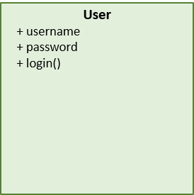
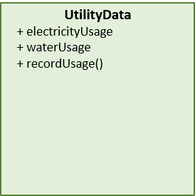
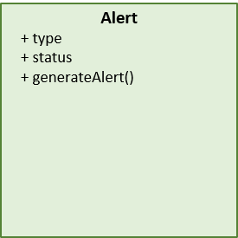
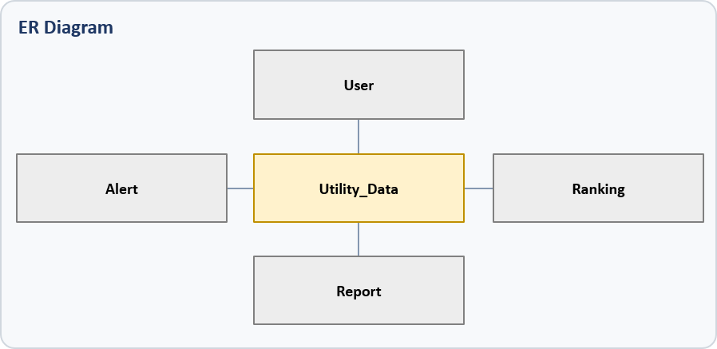
System / Product Design
Class Diagram
Use Case
Login, enter utility data, monitor, detect anomalies, view rankings and reports.
Class / Component
User, UtilityData, Alert, EnergyCompetition and Report components.
Sequence
User → Web UI → Backend API → Processing → Response.
Data Design
Utility data, alerts, rankings and reports form the core information structure.

Slide 14
Technology Stack & Tools
Frontend
HTML – structure CSS – interface design JavaScript – interactions and API calls
Backend
Java 21 Spring Boot 3.3.5
Server
Embedded Apache Tomcat
Build Tool
Maven – build and dependency management
Project Structure
src/main/resources/static/index.html app.css app.js
Development
Web browser + Java/Spring Boot development environment

Slide 15
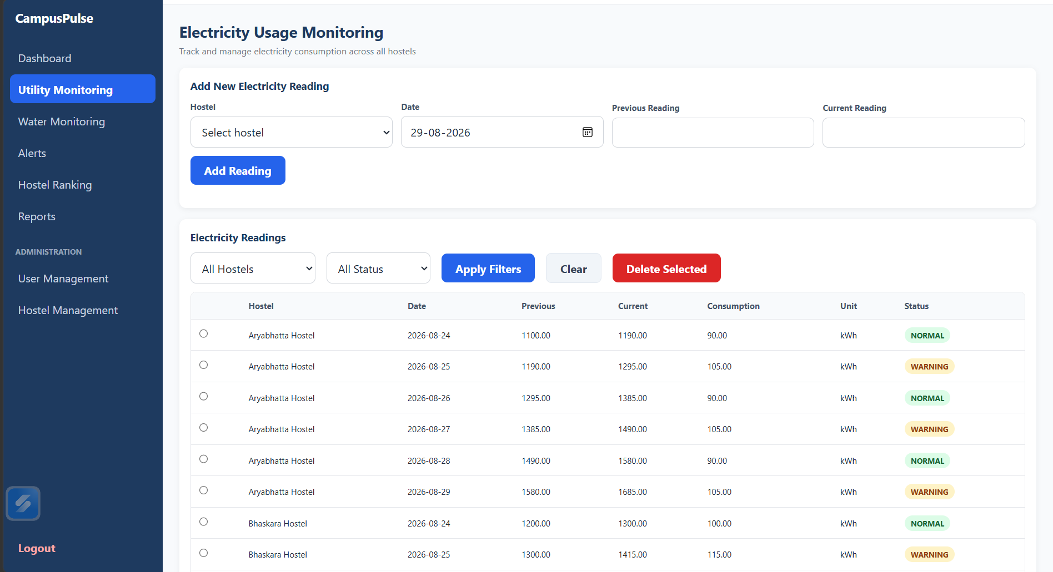
Module / Component 1 – Utility Monitoring
Input
Electricity and water usage details
Processing
Validate and organize utility information
Evidence
Web-based forms and data-driven display
Output
Centralized monitoring information and dashboard values

Slide 16
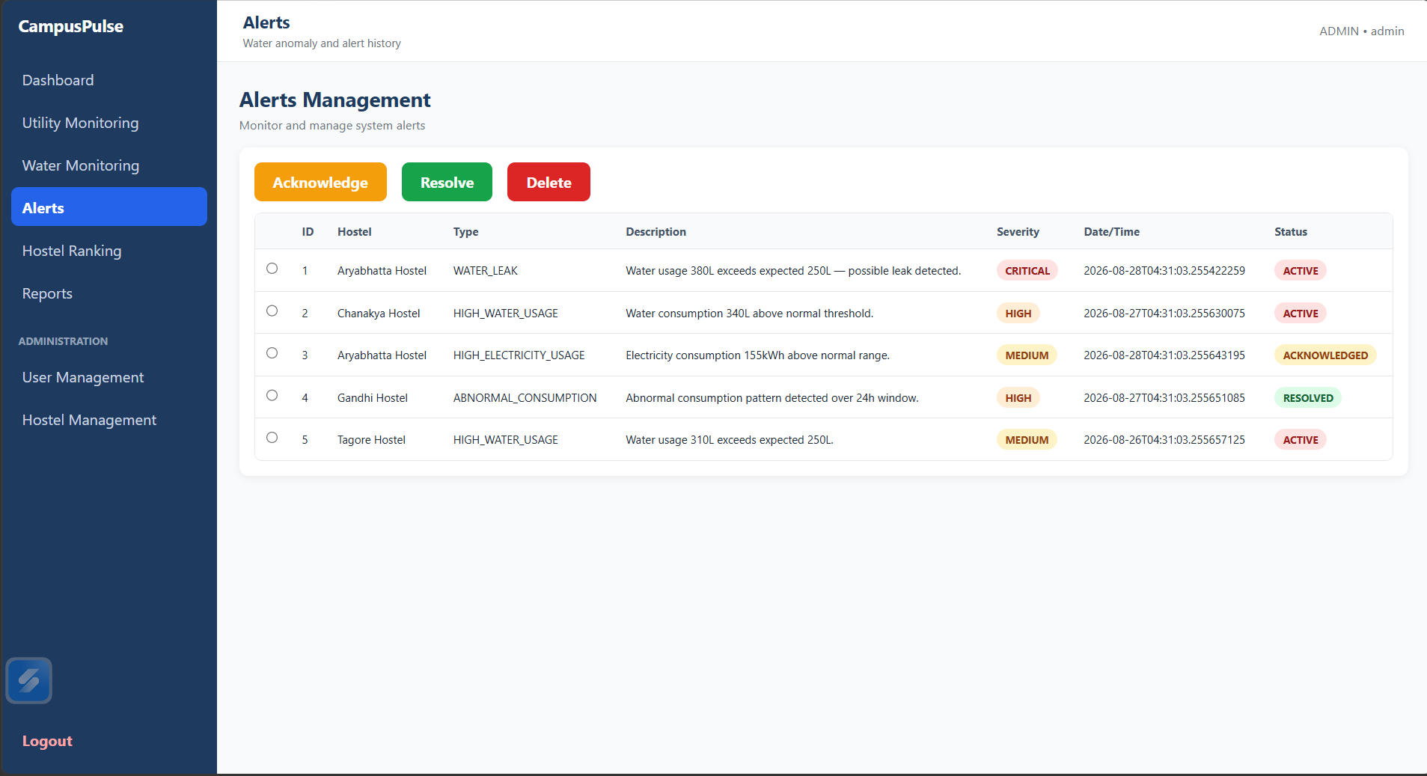
Module / Component 2 – Leak Detection & Anomaly Alert
Input
Water-usage readings and patterns
Processing
Analyze for abnormal consumption behaviour
Engineering Focus
Validation and clear alert visibility
Output
Anomaly flag and alert generation

Slide 17
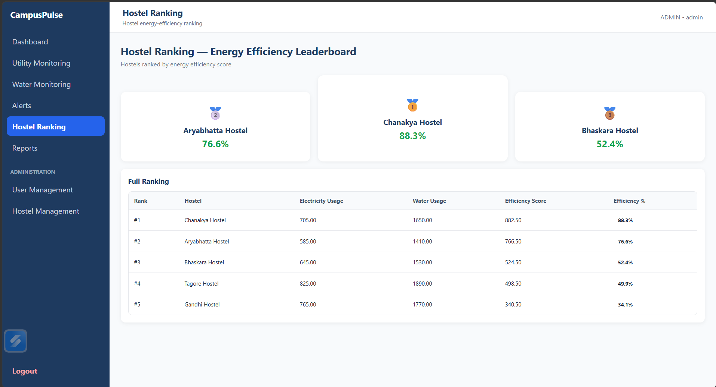
Module / Component 3 – Gamified Energy Competition
Input
Energy usage/performance information
Processing
Calculate comparative efficiency
Purpose
Encourage awareness and energy-efficient behaviour
Output
Hostel ranking and leaderboard

Slide 18
Key Algorithm / Technical Implementation
Collect Usage
Validate
Store / Process
Analyze
Generate Output
→
→
→
→
Anomaly Logic
Compare incoming water usage with expected or previously established patterns; flag significant abnormal consumption.
Energy Ranking
Calculate a comparable efficiency indicator and order hostel blocks accordingly.
Technical Decision
Separate frontend presentation from Spring Boot backend logic for maintainability and easier deployment.
API Interaction
JavaScript handles user interactions and communicates with backend endpoints.

Slide 19
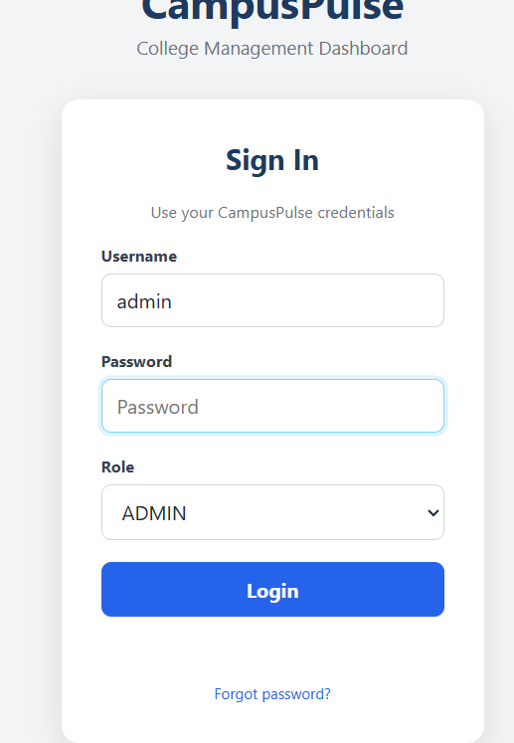
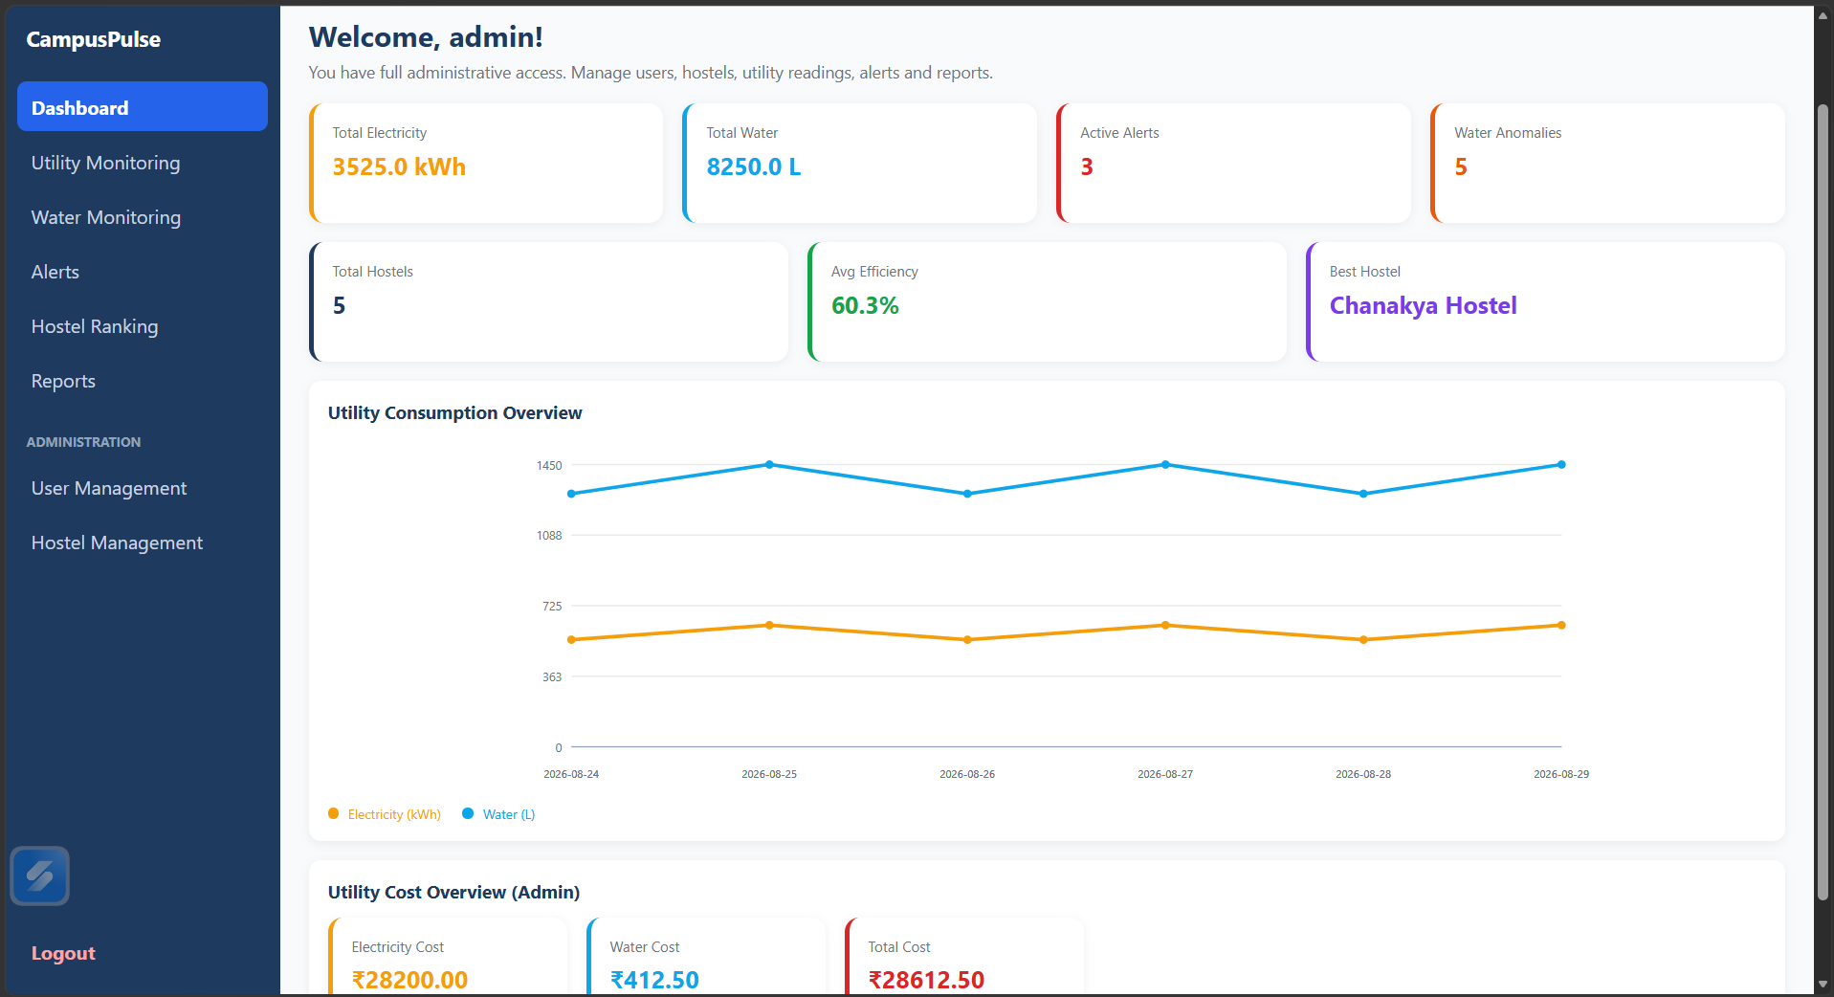
Prototype / Working Model

Slide 20
Testing & Validation
Unit Testing
Login validation, utility processing, anomaly logic, efficiency calculation and alert generation.
Integration Testing
Web UI → Backend API → Processing → Response.
Validation Focus
Correct handling of valid/invalid inputs and expected output generation.
Expected Evidence
Functional outputs, alert behaviour, ranking correctness and report consistency.

Slide 21
Results & Performance Analysis
Functional Result
The integrated design supports centralized utility monitoring.
Leak Detection Result
Abnormal water-usage conditions can be surfaced as alerts.
Competition Result
Energy information can be transformed into comparative rankings.
Web Migration Benefit
Browser-based access separates UI from backend logic and simplifies centralized deployment.
Note
Quantitative benchmark values can be added after final execution/testing.

Slide 22
Comparison with Existing Solutions
Aspect
Existing / Fragmented Approach
Proposed Web Application
Access
Manual / separate or desktop-oriented
Browser-based centralized access
Monitoring
Separate utility views
Integrated electricity + water monitoring
Leak Handling
Reactive or delayed
Pattern-based anomaly alerts
Energy Engagement
Limited comparison
Gamified hostel ranking
Architecture
UI and logic may be tightly coupled
Frontend + API backend separation

Slide 23
Challenges & Engineering Decisions
Architecture Migration
Changed from the earlier desktop concept to a browser-based web architecture.
UI–Backend Integration
Used JavaScript API interactions with a Spring Boot backend.
Module Coordination
Defined clear responsibilities for monitoring, anomaly detection and competition.
Data Flow
Structured flow from user action to processing and dashboard output.
Testing
Separated unit-level logic validation from integration-level workflow validation.
Trade-off
Web architecture improves accessibility but requires careful API and deployment coordination.

Slide 24
Individual Contributions
I. MD IMTHIAZ (192521360)
Project contribution: module design, implementation and validation responsibilities to be finalized with evidence.
G SAI DEEPAK (19231142)
Project contribution: web application development, frontend/backend support and presentation/documentation responsibilities to be finalized with evidence.
Team Contribution
Joint requirement analysis, architecture refinement, testing planning and project review preparation.

Slide 25
Project Progress / Milestones
Problem Identification
Completed
Review-1 Feedback Analysis
Completed
Three-Module Architecture
Completed
UML / Database Planning
Completed
Desktop → Web Architecture Change
Completed
Frontend Development
In Progress / Implemented
Spring Boot Backend
In Progress / Implemented
Full Integration & Validation
Final Stage
Deployment & Documentation
Final Stage

Slide 26
Limitations
Current project scope focuses on the defined three software modules.
Anomaly accuracy depends on the available water-usage data and chosen detection logic.
Real-time IoT sensor integration is outside the current prototype scope unless added in the next phase.
Quantitative performance benchmarking requires final deployment-scale testing.
Future production deployment would require stronger authentication, monitoring and security hardening.

Slide 27
Future Enhancements
IoT Integration
Automatic electricity and water data collection through sensors/meters.
Advanced Analytics
Machine learning-based anomaly detection and consumption forecasting.
Notifications
Email/SMS/app notifications for critical alerts.
Scalability
Support additional buildings, campuses and user roles.
Mobile Access
Responsive or dedicated mobile experience.
Commercialization
Potential smart-campus sustainability platform with configurable modules.

Slide 28
Conclusion & Project Outcomes
The project addresses the need for integrated smart-campus utility monitoring.
The solution combines utility monitoring, water anomaly alerts and gamified energy competition.
The project architecture has evolved from a desktop-oriented concept into a web application using HTML, CSS, JavaScript, Java 21 and Spring Boot 3.3.5.
The modular design supports maintainability, clearer data flow and future enhancement.
Expected outcome: improved visibility, faster identification of abnormal water usage and increased awareness of energy efficiency.

Slide 29
References
Spring Boot Documentation – Spring Boot 3.3.x reference material.
Java Documentation – Java 21 language and platform resources.
Apache Maven Documentation – build and dependency management.
HTML, CSS and JavaScript web development documentation.
Research and technology literature related to smart campuses, energy monitoring, water anomaly detection and sustainable computing.

Slide 30
Project Hosting / Deployment Link
Live Url: https://campuspulse123.onrender.com
GitHub : https://github.com/Imthiaz-123/campuspulse123

